Slide 1
Prolog

Slide 2
Introduction
Prolog presents a view of programming that is very different from most other programming languages.
There is a famous text book entitled
“Algorithms + Data Structures = Programs”
This formula represents well the conventional approach to programming that most programming languages support.
In Prolog there is an alternative rule of programming:
“Algorithms = Logic + Control”
This rule encompasses a non-procedural view of programming.
Logic (what the program is to compute) comes first.
Then control (how to implement the logic) is considered.
In Prolog we program the logic of a program, but the Prolog system automatically implements the control.
Logic is essential—control is just efficiency.

Slide 3
Logic Programming
Prolog implements logic programming; in fact, Prolog means Programming in Logic.
In Prolog programs are statements of rules and facts.
Program execution is deduction—can an answer be inferred from known rules and facts.
fatherOf(tom, dick).
fatherOf(dick, harry).
fatherOf(jane, harry).
motherOf(tom, judy).
motherOf(dick, mary).
motherOf(jane, mary).
The symbols fatherOf and motherOf are predicates.
The symbols tom, dick, harry, judy, mary, and jane are atoms.

Slide 4
Elementary Data Objects
In Prolog integers and atoms are the elementary data objects.
fatherOf(tom, dick).
Integers are ordinary integer literals and values.
Atoms are identifiers that begin with a lower-case letter (much like symbolic values in Scheme).
In Prolog data objects are called terms.
In Prolog we define relations among terms (integers, atoms or other terms).
A predicate names a relation. Predicates begin with lower-case letters.
To define a predicate, we write clauses that define the relation.
There are two kinds of program clauses, facts and rules.
A fact is a predicate that prefixes a sequence of terms, and which ends with a period (".").
Once we have entered rules and facts that define relations, we can make queries (ask the Prolog system questions).
Exercise 1

Slide 5
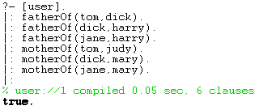

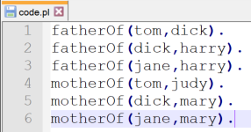
Definition Mode
Prolog has two interactive modes that you can switch between; we can define facts and rules in Definition Mode.
Via Command-Line
Via Files (Recommended)
Enter:
You can edit a file and (re)-load a file easily using:
['filename'].
where your facts and rules are defined in the file named filename.
[user].
Define rules and facts.
Terminate this phase with ^D (control-D) (end of file).
Exercise 2

Slide 6
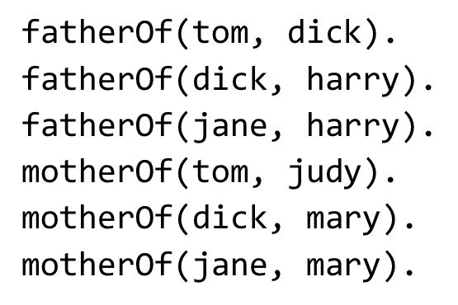


Query Mode
When you start Prolog, or after you leave definitions mode, you are in query mode. In query mode you see a prompt of the form
?-
In query mode, Prolog allows you to ask whether a relation among terms is true or false.
Given our definitions of motherOf and fatherOf relations, we can pose queries.
A "true" or "yes" response means that Prolog is able to conclude from the facts and rules it has been given that the relation queried does hold.
A "false" or "no" response to a query means that Prolog is unable to conclude that the relation holds from what it has been told. The relation may actually be true, but Prolog may lack necessary facts or rules to deduce this.
Exercise 3-6

Slide 7



Variables in Queries
One of the attractive features of Prolog is the fact that variables may be included in queries.
A variable always begins with a capital letter.
When a variable is seen, Prolog tries to find a value (binding) for the variable that will make the queried relation true.
The query fatherOf(X, harry) asks Prolog to find an value for X such that X’s father is harry.
When we enter the query, Prolog gives us a solution (if one can be found):
If no solution can be found, false is indicated.
Exercise 7
Solutions to queries do not have to be unique, Prolog will give us alternate solutions if we ask for them.
We do so by entering a “;” after a solution is printed. We get a “no” when no more solutions can be found:
Exercise 8

Slide 8

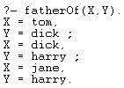
Variables in Queries (continued)
Variables may be placed anywhere in a query.
We may use more than a single variable:
This query displays ALL the fatherOf relations.

Slide 9


Conjunction of Goals
More than one relation can be included as the "goal" of a query. A comma (",") is used as an AND operator to indicate a conjunction of goals—all must be satisfied by a solution to the query.
Exercise 9
A given variable may appear more than once in a query. The same value of the variable must be used in all places in which the variable appears (this is called unification).

Slide 10
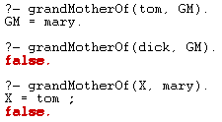
Rules in Prolog
Rules allow us to state that a relation will hold depending on the truth (correctness) of other relations.
In effect a rules says, "If I know that certain relations hold, then I also know that this relation holds."
A rule in Prolog is of the form
rel₁ :- rel₂, rel₃, ... rel_{n}.
This says rel₁ can be assumed true if we can establish that rel₂ and rel₃ and all relations to rel_{n} are true.
rel₁ is called the head of the rule. rel₂ to rel_{n} form the body of the rule.
A construction like the following two rules may define* a grandMotherOf relation using the motherOf and fatherOf relations:
grandMotherOf(X, GM) :- motherOf(X, M), motherOf(M, GM).
grandMotherOf(X, GM) :- fatherOf(X, F), motherOf(F, GM).
* These representation of relationships are outdated, but form good Prolog examples.

Slide 11
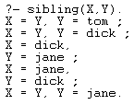

Rules in Prolog (continued)
As is the case for programming, in all languages, you must be careful when you define a rule that it correctly captures the idea you have in mind. Consider the following rule that defines an (outdated) sibling relation between two people:
sibling(X,Y) :- motherOf(X,M), motherOf(Y,M), fatherOf(X,F), fatherOf(Y,F).
This rule says that X and Y are siblings if each has the same mother and the same father. But the rule is wrong! Why?
That’s right, you can’t be your own sibling. So we refine the rule to force X and Y to be distinct:
sibling(X,Y) :- motherOf(X,M), motherOf(Y,M),
fatherOf(X,F), fatherOf(Y,F), not(X = Y).
Distinct but equivalent solutions (like X = dick,Y = jane vs. X = jane,Y = dick) often appear in Prolog solutions. You may need to “filter out” solutions that are effectively redundant (by formulating stricter or more precise rules).
not is a predefined relation.

Slide 12
How Prolog Solves Queries
The unique feature of Prolog is that it automatically chooses the facts and rules needed to solve a query. But how does it make its choice?
It starts by trying to solve each goal in a query, left to right (recall goals are connected using “,” which is the and operator).
For each goal it tries to match a corresponding fact or the head of a corresponding rule.
A fact or head of rule matches a goal if:
Both use the same predicate.
Both have the same number of terms following the predicate.
Each term in the goal and fact or rule head match (are equal), possibly binding a free variable to force a match.

Slide 13
How Prolog Solves Queries (continued)
For example, assume we wish to match the following goal:
x(a, B)
For each goal it tries to match a corresponding fact or the head of a corresponding rule.
This can match the fact:
x(a, b).
Or, can match the head of the rule:
x(Y, Z) :- Y = Z.
y(a, b)
(wrong predicate name)
Several others cannot match:
x(b, d)
(first terms do not match)
x(a, b, c)
(wrong number of terms)
If we succeed in matching a rule, we have solved the goal in question; we can go on to match any remaining goals.
If we match the head of a rule, we are not done—we add the body of the rule to the list of goals that must be solved.
If we match the goal x(a, B) with the rule
x(Y, Z) :- Y = Z.
We must solve a = B.
So, we make B equal to a.

Slide 14
Backtracking
If we reach a point where a goal cannot be matched, or the body of a rule cannot be matched, we backtrack to the last (most recent) spot where a choice of matching a particular fact or rule was made.
We then try to match a different fact or rule. If this cannot be done, we go back to the next previous place where a choice was made and try a different match there.
We try alternatives until we are able to solve all the goals in our query or until all possible choices have been tried and found to fail.
If this happens, we answer “no” the query can’t be solved.
As we try to match facts and rules we try them in their order of definition.
Depth-first search.

Slide 15
Backtracking Example
Our database:
Query:
grandMotherOf(X,GM) :- motherOf(X,M), motherOf(M,GM).
grandMotherOf(X,GM) :- fatherOf(X,F), motherOf(F,GM).
fatherOf(tom,dick).
fatherOf(dick,harry).
fatherOf(jane,harry).
motherOf(tom,judy).
motherOf(dick,mary).
motherOf(jane,mary).
?- grandMotherOf(tom, GM).
We try the first grandMotherOf rule first.
This forces X = tom.
We have to solve:
motherOf(tom,M), motherOf(M,GM).
This forces M = judy.
No other motherOf rule can solve motherOf(tom,M).
motherOf(judy,GM)
None of the motherOf rules match this goal, so we backtrack.

Slide 16
Backtracking Example (continued)
grandMotherOf(X,GM) :- motherOf(X,M), motherOf(M,GM).
grandMotherOf(X,GM) :- fatherOf(X,F), motherOf(F,GM).
fatherOf(tom,dick).
fatherOf(dick,harry).
fatherOf(jane,harry).
motherOf(tom,judy).
motherOf(dick,mary).
motherOf(jane,mary).
Query:
?- grandMotherOf(tom, GM).
We try the second grandMotherOf rule.
This forces X = tom.
We have to solve:
fatherOf(tom,F), motherOf(F,GM).
We can match:
fatherOf(tom,dick).
motherOf(dick,GM)
We can match:
motherOf(dick, mary).
This forces F = dick.
We have matched all our goals, so we know the query is true, with GM = mary.
None of the fatherOf rules match this goal, so we backtrack.
No other motherOf rule can solve motherOf(dick, GM).
Exercise 10

Slide 17
Query Overview
motherOf(jane, mary)
motherOf(tom,judy)
fatherOf(jane,harry)
motherOf(tom,judy)
motherOf(dick, mary)
motherOf(dick, mary)
fatherOf(dick, harry)
motherOf(dick, mary)
motherOf(tom, judy)
motherOf(jane, mary)
fatherOf(tom, dick)
motherOf(jane, mary)
X= ,
M=
X= ,
M= ,
GM=
X= ,
F=
X= ,
F=
motherOf(X, M), motherOf(M, GM)
fatherOf(X, F), motherOf(F, GM)
X= ,
GM=
X= ,
GM=
grandMotherOf(X, GM)

Slide 18
Visualizing Prolog Query Search I
motherOf(tom,judy)
motherOf(dick, mary)
motherOf(tom, judy)
motherOf(jane, mary)
X=tom,
M=judy
X=tom,
M=judy,
GM=?
motherOf(X, M), motherOf(M, GM)
X=?,
GM=?
grandMotherOf(X, GM)

Slide 19
Visualizing Prolog Query Search II
motherOf(tom,judy)
motherOf(dick, mary)
motherOf(dick, mary)
motherOf(jane, mary)
X=dick,
M=mary
X=dick,
M=mary,
GM=?
motherOf(X, M), motherOf(M, GM)
X= ,
GM=
grandMotherOf(X, GM)

Slide 20
Visualizing Prolog Query Search III
motherOf(jane, mary)
motherOf(tom,judy)
motherOf(dick, mary)
motherOf(jane, mary)
X=jane,
M=mary
X=jane,
M=mary,
GM=
motherOf(X, M), motherOf(M, GM)
X= ,
GM=
grandMotherOf(X, GM)

Slide 21
Visualizing Prolog Query Search IV: New Rule
motherOf(jane, mary)
motherOf(tom,judy)
fatherOf(jane,harry)
motherOf(tom,judy)
motherOf(dick, mary)
motherOf(dick, mary)
fatherOf(dick, harry)
motherOf(dick, mary)
motherOf(tom, judy)
motherOf(jane, mary)
fatherOf(tom, dick)
motherOf(jane, mary)
X= ,
M=
X= ,
M= ,
GM=
X= ,
F=
X= ,
F= ,
GM=
motherOf(X, M), motherOf(M, GM)
fatherOf(X, F), motherOf(F, GM)
X= ,
GM=
X= ,
GM=
grandMotherOf(X, GM)

Slide 22
Visualizing Prolog Query Search V
motherOf(tom,judy)
motherOf(dick, mary)
fatherOf(tom, dick)
X=tom,
F=dick
X=tom,
F=dick,
GM=?
GM=mary
fatherOf(X, F), motherOf(F, GM)
X=?,
GM=?
X=tom,
GM=mary
grandMotherOf(X, GM)

Slide 23
Visualizing Prolog Query Search VI
fatherOf(tom, dick)
motherOf(jane, mary)
X=tom,
F=dick
X=tom,
F=dick,
GM=?
fatherOf(X, F), motherOf(F, GM)
X=?,
GM=?
grandMotherOf(X, GM)

Slide 24
Visualizing Prolog Query Search VII
motherOf(tom,judy)
fatherOf(dick, harry)
motherOf(dick, mary)
motherOf(jane, mary)
X=dick,
F=harry
X=dick,
F=harry
GM=?
fatherOf(X, F), motherOf(F, GM)
X= ,
GM=
grandMotherOf(X, GM)

Slide 25
Visualizing Prolog Query Search VIII
fatherOf(jane,harry)
motherOf(tom,judy)
motherOf(dick, mary)
motherOf(jane, mary)
X=jane,
F=harry
X=jane,
F=harry
GM=?
fatherOf(X, F), motherOf(F, GM)
X= ,
GM=
grandMotherOf(X, GM)

Slide 26
Lists
Prolog has a notation similar to cons of Scheme. The "." functor (predicate name) acts like cons.
.(a, b)
in Prolog is essentially the same as (a . b) in Scheme
Lists in Prolog are formed much the same way as in Scheme and ML:
[]
empty list
[1,2,3]
is an abbreviation for
.(1, .(2, .(3,[])))
just as (1,2,3) in Scheme is an abbreviation for
(cons 1 (cons 2 (cons 3 () )))

Slide 27
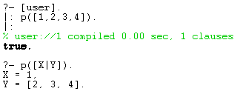


Lists (continued)
The notation [H | T] represents a list with H matching the head of the list and T matching the rest of the list.
[1, 2, 3] = [1 | [2,3]] = [1, 2 | [3]] = [1, 2, 3 | [] ]
As in ML, "_" (underscore) can be used as a wildcard or "don’t care" symbol in matches.
Exercise 11

Slide 28
List Operations
List operations are defined using rules and facts.
The definitions are similar to those used in Scheme or ML, but they are non-procedural. That is, you do not give an execution order.
Instead, you state recursive rules and non-recursive "base cases" that characterize the operation you are defining.
append([], L, L).
% Base Case
An empty list (argument 1) appended to any list L (argument 2) gives L (argument 3) as its answer.
input
output
append([H | T1], L2, [H | T3]) :- append(T1, L2, T3).
% Recursion
input
output
If we take a list that begins with H and has T1 as the rest of the list and append it to a list L2 then the resulting appended list will begin with H.
The rest of the resulting list, T3, is the result of appending T1 (the rest of the first list) with L2 (the second input list).

Slide 29

Example: append
append([], L, L).
append([H | T1], L2, [H | T3]) :- append(T1, L2, T3).
With H = 1, T1 = [], L2 = [2, 3] and T3 = [2, 3] it must be the case:
append([], [2, 3], [2, 3])
is true and fact (1) says that this is so.
Exercise 12

Slide 30

Inverting Inputs and Outputs
In Prolog the division between "inputs" and "outputs" is intentionally vague. We can exploit this.
It is often possible to "invert" a query and ask what input would compute a given output.
append([1], X, [1,2,3]).
This asks Prolog to find a list X such that if we append [1] to X we will get [1,2,3].

Slide 31
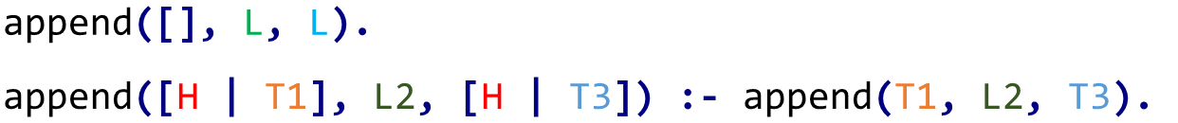
Inverting Inputs and Outputs (continued)
append([1], X, [1,2,3]).
How does it choose this answer?
Prolog tries to match the query against Fact (1).
Fact (1) doesn’t match (the first arguments differ)
append([], L, L).
append([1], X, [1,2,3]).
We try to match rule (2) (Prolog would perform this exhaustive search even if Fact 1 failed / succeeeded).
append([H | T1], L2, [H | T3])
:- append(T1, L2, T3).
H = 1
L2 = X
'Substituting' / Solving the body of Rule (2):
T3 = [2,3]
T1 = []
append([], L2, [2,3]).
This tells us L2 = [2,3] = X. Our answer!
append([1], X, [1,2,3]).
Exercise 13

Slide 32
Member Relation
A common predicate when manipulating lists is a membership test—is a given value in a list?
An “obvious” definition is a recursive one similar to what we might program in Scheme or ML:
Definitions state:
member(X, [X | _]).
X is a member of the second argument (a list) if X matches the head of the list.
member(X, [_ | Y]) :- member(X, Y).
X is (recursively) a member of the rest of the list.
Note: we do not have to "tell" Prolog that X cannot be a member of an empty list—if we don’t tell Prolog that something is true, it automatically assumes that it must be false.
Exercise 14

Slide 33
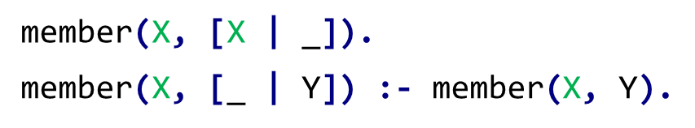
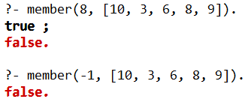
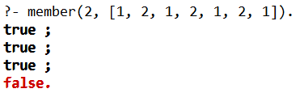
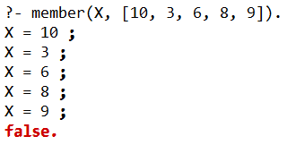
Exhaustive Member Search
We can use member for its classic interpretation as a Boolean function: is a value in a given list?
What if a particular value occurs multiple times in a list?
We can thus use the member relation to cycle through a list.
(This seems inefficient in some situations.)
Exercise 15

Slide 34

Member Relation (continued)
Since inputs and outputs in a relation are blurred, we can use member in an unexpected way—to iterate through a list of values.
If we want to know if any member of a list L satisfies a predicate p, we can write:
member(X, L), p(X).
There is no explicit iteration or searching in Prolog.
We simply ask Prolog to find an X such that member(X, L) is true (X is in L) and p(X) is true. Backtracking will find the "right" value for X (if any such X exists).
Identify all numbers in a list:
member(X, [1, "hi", 4, "p", 3.14]), number(X).
Exercise 16

Slide 35
Sorting Algorithms
Sorting algorithms are good examples of Prolog’s definitional capabilities.
In a Prolog definition the “logic” of a sorting algorithm is apparent, stripped of the cumbersome details of data structures and control structures that dominate algorithms in other programming languages.
Consider the simplest, yet naïve, sort imaginable: a permutation sort.
Sorting a list L requires two things:
The sorting is a permutation (a reordering) of the values in L.
The values are “in order” (ascending or descending).
We can implement this concept directly in Prolog:
Permute an input list
Check if it is in sorted order
Repeat (a) and (b) until a sorting is found.

Slide 36

Permutations
How are permutations defined in Prolog?
In most languages generating permutations is non-trivial—you need data structures to store the permutations you are generating and control structures to visit all permutations in some order.
In Prolog, permutations are defined quite concisely, though with a bit of subtlety:
perm(X, Y) will be true if list Y is a permutation of list X.
We start with the base case: an empty list may only be permuted into another empty list.
perm([], []).
L
A list L is a permutation of [H | T] if:
L may be partitioned into two lists, V and [H | U]. (That is, H is somewhere in the "middle" of L).
Lists V and U (all of L except H) may be appended into list W.
List W may be permuted into T.
V
U
H
H
V
U
perm(L, [H | T]) :- append(V, [H | U], L), append(V, U, W), perm(W, T).
W

Slide 37
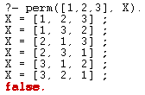
Permutation Trace
perm(L, [H | T]) :- append(V, [H | U], L), append(V, U, W), perm(W, T).
perm([1,2,3], X)
L = [1,2,3]
X = [H | T]
append(V, [H | U], [1,2,3])
append([], [2,3], W)
perm([2,3], T)
One solution is:
Only solution:
T1 = [2,3]
V = [], H = 1, U = [2,3]
W = [2,3]
T2 = [3,2]
Backtrack to our last 'choice':
Resulting in:
Resulting in:
X = [H | T] = [1,2,3]
X = [H | T] = [1,3,2]

Slide 38
Permutation Trace (continued)
perm(L, [H | T]) :- append(V, [H | U], L), append(V, U, W), perm(W, T).
perm([1,2,3], X)
L = [1,2,3]
X = [H | T]
append(V, [H | U], [1,2,3])
append([1], [3], W)
perm([1,3], T)
Another solution is:
Only solution:
T1 = [1,3]
V = [1], H = 2, U = [3]
W = [1,3]
T2 = [3,1]
Backtrack to our last 'choice':
Resulting in:
Resulting in:
X = [H | T] = [2,1,3]
X = [H | T] = [2,3,1]
And so forth; there are 2 more bindings.

Slide 39

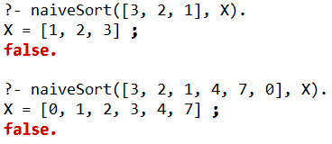
A Permutation Sort
Given rules that generate permutations, we almost have a sort. We can define an inOrder relation that characterizes our notion of when a list is sorted:
inOrder([]).
Empty list is ordered.
inOrder([_]).
A list containing 1 element is sorted.
inOrder([A, B | T]) :- A =< B, inOrder([B|T]).
Check if the first two list elements are ordered.
Check that the tail of the original list is ordered.
We can define our sort:
naiveSort(L1, L2) :- perm(L1, L2), inOrder(L2).
The sort works, but is inefficient. This process is largely undirected: we do not "aim" toward a correct ordering, but just search until we get lucky.

Slide 40
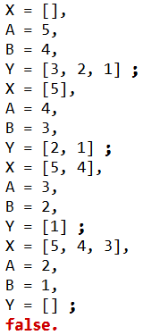
Sorting Pre-Requisite: Traversing Pairs of a List
We have seen how we can essentially traverse a list using the member predicate. In a similar manner, we can use the append predicate to sequential split up a list into parts (while also giving access to specific pairs of elements).
append(X, [A, B | Y], L1).
This predicate partitions L1 into two lists, X and [A,B|Y] (exposing two adjacent values). However, since matching will be exhaustive, we will split L1 into all possible combinations: when X is empty, when X contains 1 element, etc.
A
L1:
X
Y
B

Slide 41
Bubble Sort
Recall the idea for the bubble sort is simple:
Examine a list of values, looking for a pair of adjacent values that are “out of order.”
For an unordered pair, we swap the two values (placing them in correct order).
If we do not find an unordered pair, the list must be in sorted order and we are done.
bubbleSort(L, L) :- inOrder(L).
We are done if L is sorted.
We define what it means for list L2 to be a sorting for list L1.
Partition L1 into two lists, X and [A,B|Y] (exposing two adjacent values).
A
bubbleSort(L1, L2) :- append(X, [A, B | Y], L1),
A > B,
append(X, [B, A | Y], T),
bubbleSort(T, L2).
L1:
X
Y
B
[If] The first two values are out of order.
List T is really L1, with A and B swapped: B followed by A.
T is an 'improved' list that we continue to bubble-sort into L2.
Exercise 17

Slide 42
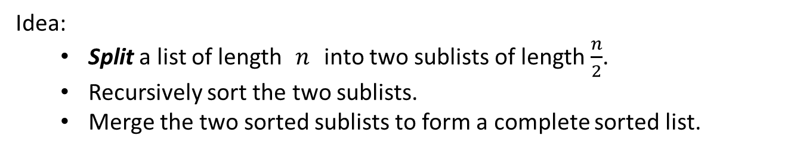
Merge Sort (split)
Idea:
Split a list of length $n$ into two sublists of length $\frac{n}{2}$.
Recursively sort the two sublists.
Merge the two sorted sublists to form a complete sorted list.
We first need Prolog rules on how to split a list into two equal halves:
split([],[],[]).
An empty list can be partitioned into two empty lists.
split([A],[A],[]).
A list with a single element can be split into a singleton list and an empty list.
split([A,B|T], [A|P1], [B|P2]) :- split(T,P1,P2).
Distribute the first two elements (A and B) into two sublists.
Recursively split the rest of the list.

Slide 43
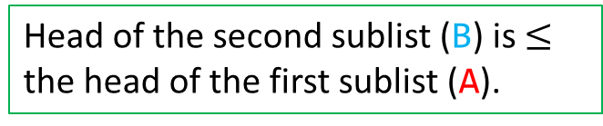
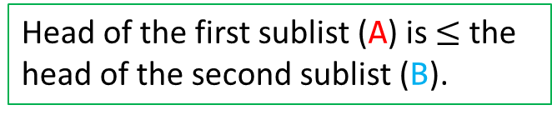
Merge Sort (merge)
merge([], L, L).
Merging a 'left' null list: merge([], L) -> L
merge(L, [], L).
Merging a 'right' null list: merge(L, []) -> L
merge([A | T1], [B | T2], [A | L2]) :- A =< B, merge(T1, [B | T2], L2).
Head of the first sublist (A) is $≤$ the head of the second sublist (B).
Recursively merge the two lists (minus A, the new head of [A | L2]).
merge([A | T1], [B | T2], [B | L2]) :- A > B, merge([A | T1], T2, L2).
Head of the second sublist (B) is $≤$ the head of the first sublist (A).
Recursively merge the two lists (minus B, the new head of [B | L2]).

Slide 44
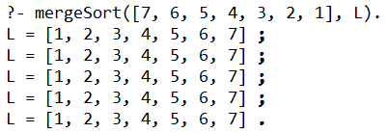
Merge Sort (mergeSort)
mergeSort([],[]).
Base Cases: a list of length 0 or 1 are trivially sorted.
mergeSort([A],[A]).
mergeSort(L1, L2) :- split(L1, P1, P2),
mergeSort(P1, S1),
mergeSort(P2, S2),
merge(S1, S2, L2).
Partition L1 into P1 and P2.
L1:
P1
P2
mergeSort(P1) -> S1.
mergeSort(P2) -> S2.
Merge the sorted partitions into the resulting L2.

Slide 45
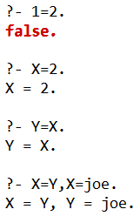
Arithmetic in Prolog
The = predicate can be used to test bound variables for equality (actually, identity). If one or both of =’s arguments are free variables, = forces a binding or an equality constraint.

Slide 46



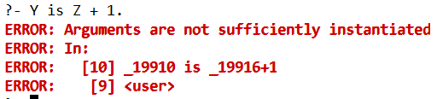
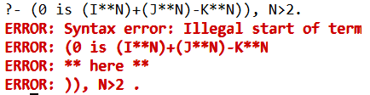
Arithmetic Terms are Symbolic
Evaluation of an arithmetic term into a numeric value must be forced. That is, 1+2 is an infix representation of the relation +(1,2).
This term is not an integer!
To force arithmetic evaluation, we use the infix predicate is. The right-hand side of is must be all ground terms (literals or variables that are already bound). No free (unbound) variables are allowed.
The requirement that the right-hand side of an is relation be ground is essentially procedural. It exists to avoid having to invert complex equations.
For example, solving a complex equation such as Fermat's Last Theorem:
(0 is (I**N)+(J**N)-K**N)), N>2.
Exercise 18

Slide 47


Counting in Prolog
Rules that involve counting often use the is predicate to evaluate a numeric value.
We define the relation len(L, N) which is true if the length of list L is N.
len([], 0).
Length of an empty list is 0.
len([ _ | T], N) :- len(T, M), N is M + 1.
Recursive counting of items; head of the list is inconsequential.
Normal usage computing length:
Could we acquire a list of length 2?
The symbols _11224 and _11230 are “internal variables” created as needed when a particular value is not forced in a solution.
Exercise 19

Slide 48
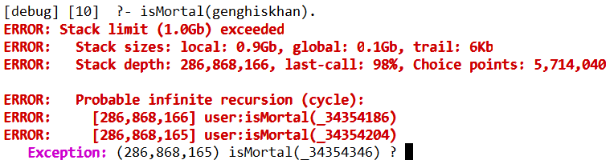
Definition Order Can Matter
Ideally, the order of definition of facts and rules should not matter.
But, in practice definition order can matter. A general guideline is to define facts before rules.
parentOf(tolui, genghiskhan).
All descendents of Genghis Khan are mortal.
isMortal(X) :- isMortal(Y), parentOf(X,Y).
isMortal(genghiskhan).
The query
isMortal(genghiskhan).
Is infinite.

Slide 49
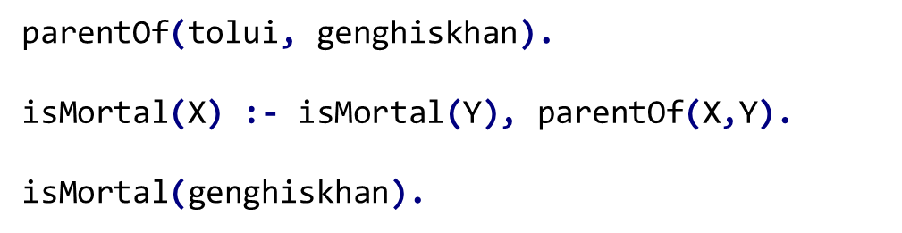
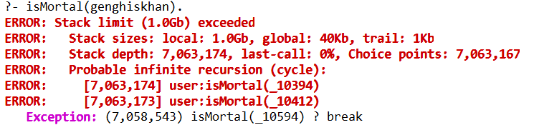
Definition Order Can Matter (cont.)
Query: isMortal(genghiskhan).
Rule 2: isMortal(X)
X=genghiskhan
isMortal(Y), parentOf(genghiskhan,Y).
Rule 2: isMortal(Y)
X=Y
isMortal(Z), parentOf(Y,Z).
…infinite expansion.

Slide 50


Definition Order Can Matter (cont.)
The solution is simple—place the "base case" fact that terminates recursion first.
parentOf(tolui, genghiskhan). isMortal(genghiskhan).
isMortal(X) :- isMortal(Y), parentOf(X,Y).
But now another problem appears! If we ask
isMortal(sully).
The problem is that Sully is a cartoon (Monsters, Inc.) and hence will not appear in our parentOf database.
We will trace this query on the next slide.

Slide 51

Definition Order Can Matter (cont.)
parentOf(tolui, genghiskhan).
isMortal(genghiskhan).
isMortal(X) :- isMortal(Y), parentOf(X,Y).
isMortal(sully).
isMortal(X)
:- isMortal(Y), parentOf(sully,Y).
Current goals.
X=sully
Try: Y=genghiskhan
isMortal(Y) :- isMortal(Z), parentOf(Y,Z).
genghiskhan is not a parent of sully.
But genghiskhan is not sully's grandparent either!
So we keep going further back, trying to find a chain of descendents that leads from genghiskhan to sully.
No such chain exists, and there is no limit to how long a chain Prolog will try.
Try:
isMortal(genghiskhan).
sully$≠$genghiskhan

Slide 52

Definition Order Can Matter (cont.)
There is a solution! Simply rewrite our recursive definition changing the order of relations.
parentOf(tolui, genghiskhan). isMortal(genghiskhan).
isMortal(X) :- parentOf(X,Y), isMortal(Y).
The recursive part of the rule is now last.
This is logically the same, but now we work from the individual X back toward genghiskhan, rather than from genghiskhan toward X. Since we have no parentOf relation involving sully, we immediately stop our search and answer false!

Slide 53
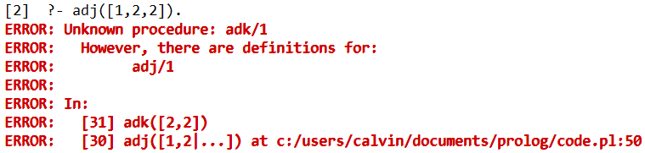
Debugging
Care is required in developing and testing Prolog programs because the language is untyped; undeclared predicates or relations are simply treated as false or cause an exception.
Consider a definition that identifies if a list has adjacent elements:
adj([A, B | _]) :- A = B.
adj([_, B | T]) :- adk([B | T]).
adj([1,2,2]).

Slide 54
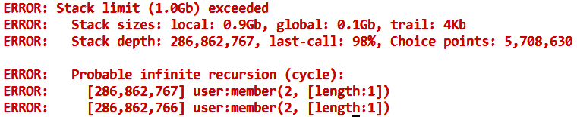


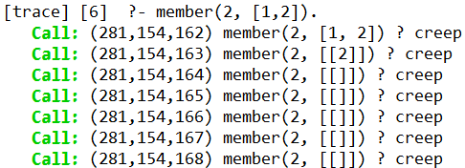
Debugging (continued)
member(A, [A | _]).
member(A, [_ | T]) :- member(A, [T]).
member(2,[1,2]).
Infinite recursion!
If you’re not sure what is going on, Prolog’s trace feature can be useful.
notrace turns tracing off.

Slide 55
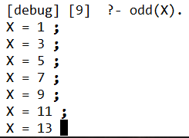

Termination Issues in Prolog
Searching infinite domains (like integers) can lead to non-termination, with Prolog trying every value.
odd(1).
odd(N) :- odd(M), N is M + 2.
An infinite search!
Consider a query in which we generate each and every odd integer and finding none is equal to 2.
An infinite search!
Prolog does have a mechanism to “cut off” fruitless searches...

Slide 56
Extra-Logical Aspects of Prolog
To make a Prolog program (1) more efficient, or (2) to represent negative information, Prolog needs features that have a procedural flavor.
These constructs are called "extra-logical" because they go beyond Prolog’s core of logic-based inference.

Slide 57
The Cut
The most commonly used extra-logical feature of Prolog is the "cut symbol":
!
A ! in a goal, fact or rule "cuts off" backtracking.
In particular, once a ! is reached (and automatically matched), we may not backtrack across it. The rule we have selected and the bindings we have already selected are "locked in" or "frozen."
x(A) :- y(A,B), z(B), ! , v(B,C).
Once the ! is hit we cannot backtrack to resatisfy y(A,B) or z(B) in some other way. We are locked into these rules, with the bindings of A and B already in place.
We can backtrack to try various solutions to v(B,C).

Slide 58
The Cut (continued)
! Cuts off backtracking (to left).
It is sometimes useful to have several ! in a rule.
This allows us to find a partial solution, lock it in, find a further solution, then lock it in, etc.
a(X) :- b(X), !, c(X, Y), ! , d(Y).
We first try to satisfy b(X), perhaps trying several facts or rules that define the b relation.
Once we have a solution to b(X), we lock it in, along with the binding for X.
Then we try to satisfy c(X, Y), using the fixed binding for X, but perhaps trying several bindings for Y until c(X, Y) is satisfied.
We then lock in this match using another !. Finally we check if d(Y) can be satisfied with the binding of Y already selected and locked in.

Slide 59
Revisiting Prolog Query Search (with Cut)
motherOf(tom,judy)
motherOf(dick, mary)
fatherOf(tom, dick)
X=tom,
F=dick
X=tom,
F=dick,
GM=?
GM=mary
fatherOf(X, F), motherOf(F, GM),!
X=?,
GM=?
X=tom,
GM=mary
grandMotherOf(X, GM)

Slide 60
Revisiting Prolog Query Search (with Cut) II
fatherOf(tom, dick)
motherOf(jane, mary)
!
X=tom,
F=dick
X=tom,
F=dick,
GM=?
fatherOf(X, F), motherOf(F, GM),!
grandMotherOf(X, GM)

Slide 61
When Are Cuts Needed?
! Cuts off backtracking (to left).
A cut can be useful in improving efficiency, by forcing Prolog to avoid useless or redundant searches.
Consider a query such as:
member(X,list1), member(X,list2), isPrime(X).
This asks Prolog to find an X that is in list1 and also in list2 and also is prime.
X will be bound, in sequence, to each value in list1.
We then check if X is also in list2, and then check if X is prime.
Assume we find X=8 is in list1 and list2. isPrime(8) fails (of course). We backtrack to member(X,list2) and try to resatisfy it with the same value of X.
But there is never any point in trying to resatisfy member(X,list2).
Once we know a value of X is in list2, we test it using isPrime(X). If it fails, we want to go right back to member(X,list1) and get a different X.

Slide 62

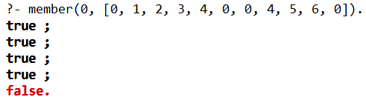
When Are Cuts Needed? (continued)
We can use ! to create a version of member that never backtracks once it has been satisfied.
memberCut(X, [X | _]) :- !.
memberCut(X, [_ | Y]) :- memberCut(X, Y).
Our query becomes:
member(X,list1), memberCut(X,list2), isPrime(X).
(Why isn’t memberCut used in both terms?)
Exercise 20-21

Slide 63
Expressing Negative Information
Sometimes it is useful to state rules about what cannot be true. Such rules can help avoid long and fruitless searches.
fail is a goal that always fails.
It can be used to represent goals or results that can never be true.
Assume we want to optimize parentOf rules by stating that an animal can never be a parent of a human.
parentOf(X,P) :- animal(P), fail.
This rule is lacking. Why?
The standard approach in Prolog is to try other rules if the current rule fails.
Hence, we need a way to "cut off" any further backtracking once this negative rule is found to be applicable.
parentOf(X,P) :- animal(P), !, fail.

Slide 64
Other Extra-Logical Operators
findall
Called as findall(X, goal, List) where X is a variable in goal.
All possible solutions for X that satisfy goal are found and placed in List.
findall(X, (append(_, [X | _], [-1, 2, -3, 4]), (X < 0)), L).
var and nonvar
var(X) tests whether X is unbound (free).
nonvar(Y) tests whether Y is bound (no longer free).
These two operators are useful in tailoring rules to particular combinations of bound and unbound variables.
parentOf(X, P) :- animal(P), !, fail.
This rule might backfire if P is not yet bound. To remedy this problem. we use the rule only when GM is bound.
parentOf(X,P) :- nonvar(P), animal(P), !, fail.

Slide 65
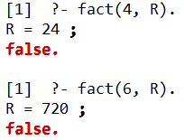
An Example of Extra-Logical Programming I
Factorial is well known, and easy to code in most languages. In Prolog the “obvious” solution is:
fact(N, 1) :- N =< 1.
fact(N, F) :- N > 1, M is N - 1, fact(M, G), F is N * G.
This definition is certainly correct. It mimics the usual recursive solution.
But, in Prolog "inputs" and "outputs" are less distinct than in most languages.
We can envision 4 different combinations of input / output pairs based on what is fixed (and thus an input) and what is free (and hence is to be computed).

Slide 66
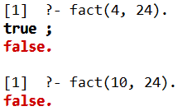

An Example of Extra-Logical Programming II
fact(N, 1) :- N =< 1.
fact(N, F) :- N > 1, M is N - 1, fact(M, G), F is N * G.
N and F are both ground (fixed): we are deciding if F = N!
N is ground and F is free. This is how we normally compute F given N: F such that F = N!
F is fixed and N is free. This is an uncommon usage: find an N such that F = N!, or determine that no such N is possible.
Both N and F are free. We generate, in sequence, pairs of N and F values such that F = N!

Slide 67
An Example of Extra-Logical Programming III
Our solution works for combinations 1 and 2 (where N is fixed).
Problem: N =< 1 and N > 1 cannot be satisfied when N is free.
We need to use nonvar and ! to form a solution that works for all 4 combinations of inputs.
We first handle the case where N is ground:
fact(1, 1).
N = 1
fact(N, 1) :- nonvar(N), N =< 1, ! .
N <= 1
fact(N, F) :- nonvar(N), N > 1, !, M is N - 1, fact(M, G), F is N * G, ! .
N > 1
The first ! in each of these rules forces that rule to be the only one used for the values of N that match.
The second ! in the third rule states that after F is computed, further backtracking is useless; there is only one F value for any given N value.

Slide 68

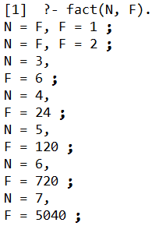
An Example of Extra-Logical Programming IV
To handle the case where F is bound and N is free, we use
fact(N, F) :- nonvar(F), !, fact(M, G), N is M + 1, F2 is N * G, F =< F2, !, F = F2.
In this rule, we generate N, F2 pairs until F2 >= F.
Then we check if F = F2. If this is so, we have the N we want. Otherwise, no such N can exist and we fail (and answer false).
For the case where both N and F are free we use:
fact(N, F) :- fact(M, G), N is M + 1, F is N * G.
This systematically generates N, F pairs, starting with N=2, F=2 and then recursively building successor values (N=3, F=6, then N=4, F=24, etc.)

